Slide 1
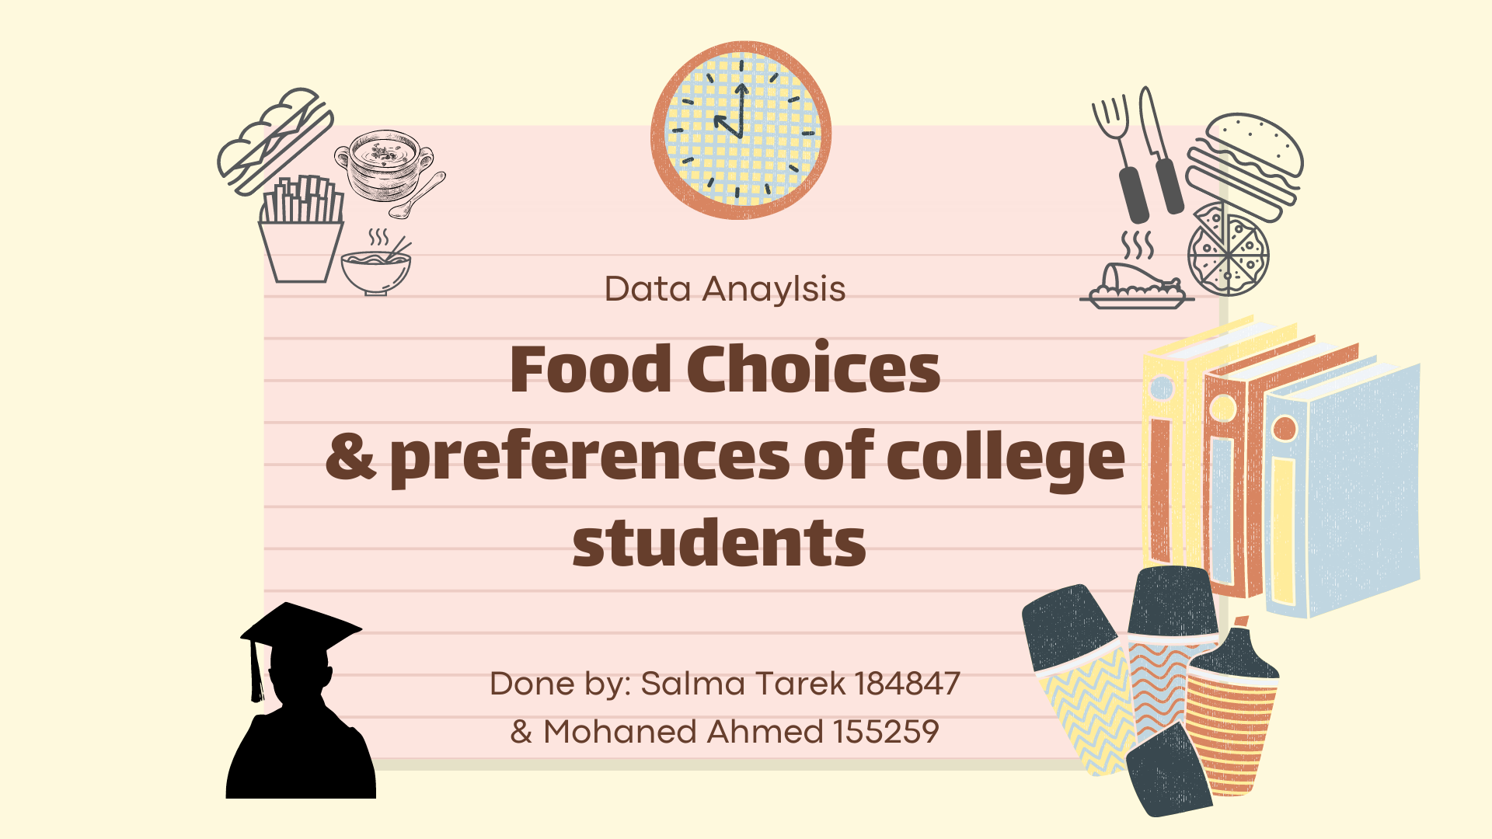

Slide 2

Introduction
Mercyhurst University is a 4 years, Catholic institution founded in 1926 by the sisters of Mercy. It’s a liberal arts college in Erie, Pennsylvania.
About 126 students from it responded on a survey about their food choices and preferences.
Forming the dataset which is about the data taken from male and female students who answered several questions regarding their GPA, comfort food and the reason behind it.
Their favorite food and their diet habit, the number of exercises they do per day, and how do their eating change along with their years in college from being freshman up till being seniors.
Also the number of their meals intake are counted which is split into turkey, chicken, waffle, tortilla and scone. Their coffee and alcoholic intake are counted etc.

Slide 3

Introduction
In addition to the students' awareness of saving the environment through testing their understandings about carbon footprint.
Carbon footprint is the greenhouse gas emissions produced by growing, rearing, farming, processing, transporting, storing, cooking and disposing of the food you eat.
The main concern is to inform students that changing the food that they eat can have a big impact on their carbon footprint, reduce pollution, preserve the environment and slow global warming.

Slide 4

Questions
The dataset will help in identifying the following:
What's the majority gender that has higher GPA ?
Does drinking coffee increase students' studying hours ?
Does vitamins have a role in students' exercises ?
Does junk food affect students' income ?
Does being busy distract you from eating junk food?
Does drinking coffee boost students' energy ?
Do vitamins intake affects student's academic performance ?
Do students eat out while studying ?
Does students caloric intake affect their weight ?
Do Vegan students' brain cells are more actively functioned ?
Does the student's food choice pollute the environment?

Slide 5
Data Preprocessing
We cleaned the unneccesary data in our projects suchs as :
Removed the students’ height that were above 189 cm.
Converted the students’ weight unit from lbs to KG .
Replaced any 0 KG weight into NA to avoid calculation errors later in the BMI.
Replaced the NA values with 0 in employed students to count the number of students who work correctly.
Remove NA values from students’ GPAs to count the number of students academic achievments correctly.
Replaced any NA values from students’ eating changes to no changes.

Slide 6

Data Preprocessing
Replaced any NA values from the students’ income by 1 which was categorized
(very poor) asumming that students were embaressed to announce it.
Categorized students’ income ascendingly to become "very poor","poor", "average","good","high","very high" instead of numbers .
Categorized students’ gender instead of 1 and 2 to be Female and Male.
Categorized students’ vitamins into Yes and No.

Slide 7
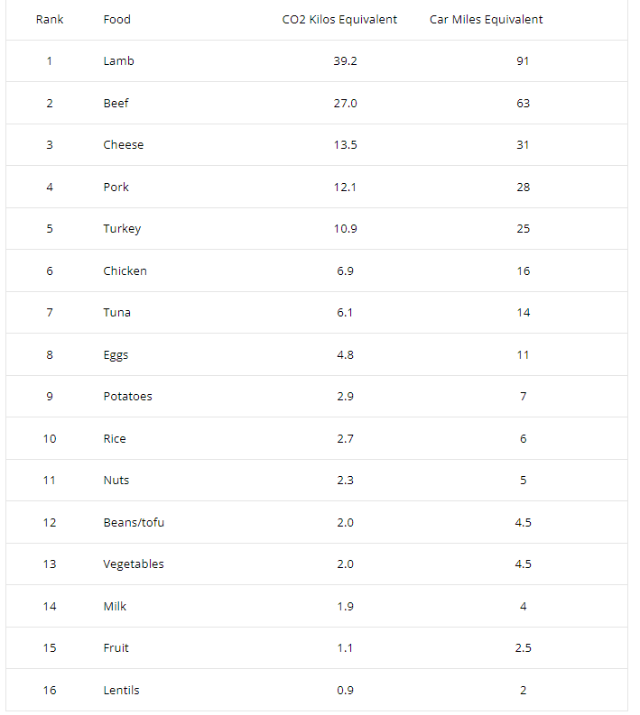
Data Preprocessing
We added columns that are related to the carbon foodprint which are co2 and car miles to check how students’ food preferences will affect the environment.
According to the figure from the Environmental Working Group’s Meat Eater’s Guide and the EPA’s Guide to Passenger Vehicle Emissions any NA values for students’ fav food was removed.
We categorized students’ fav food from 1 till 16 so it can be ranked.
Any NA values in the CO2 was removed .
Any NA values in Car miles was removed.
Any NA values in students’ Fav food was removed.

Slide 8
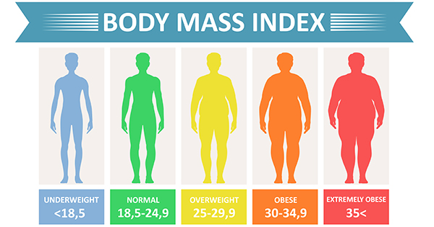
Scoring
The BMI was calculated by :Height/weightInKG ^2*703

Slide 9
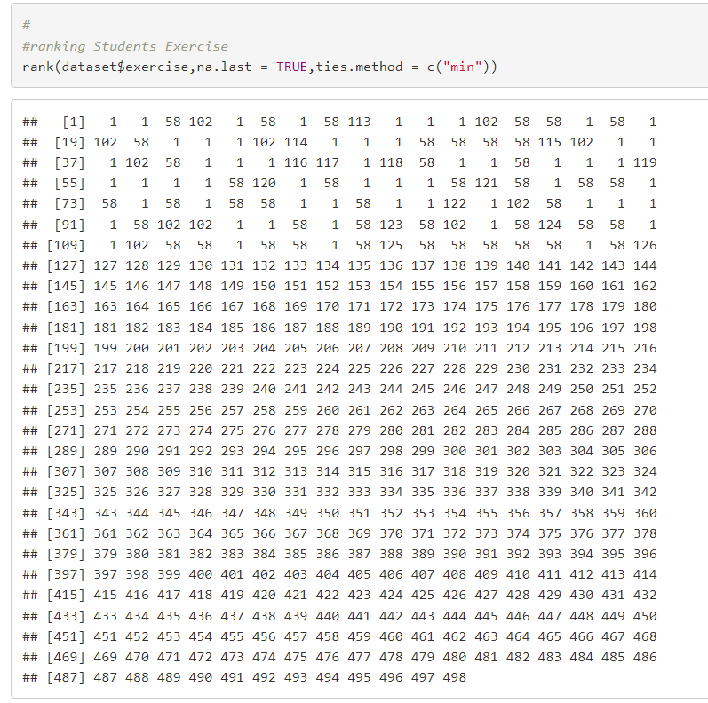
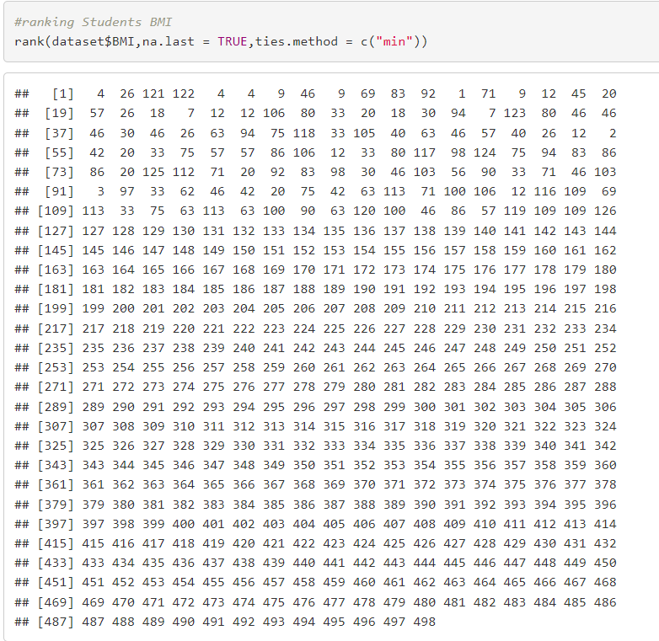
Ranking
Ranking Students Exercise
Ranking Students BMI
Ranking Students ‘GPA

Slide 10
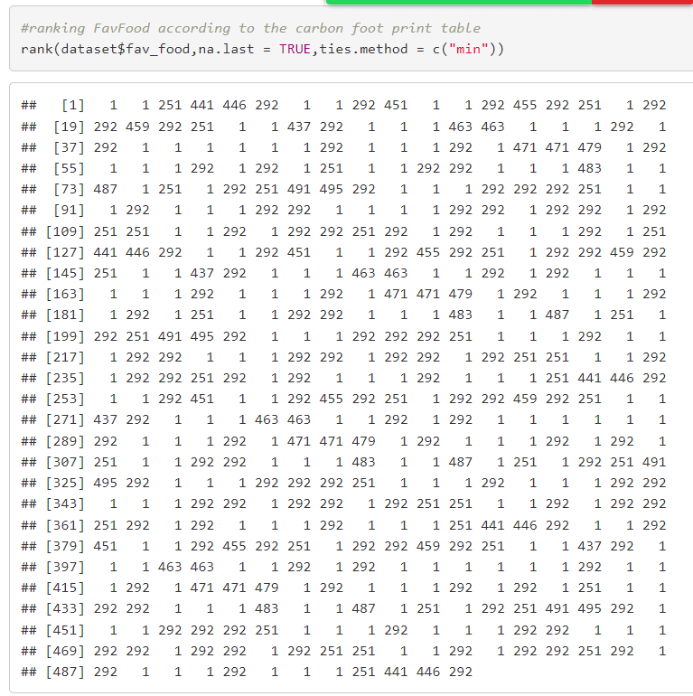
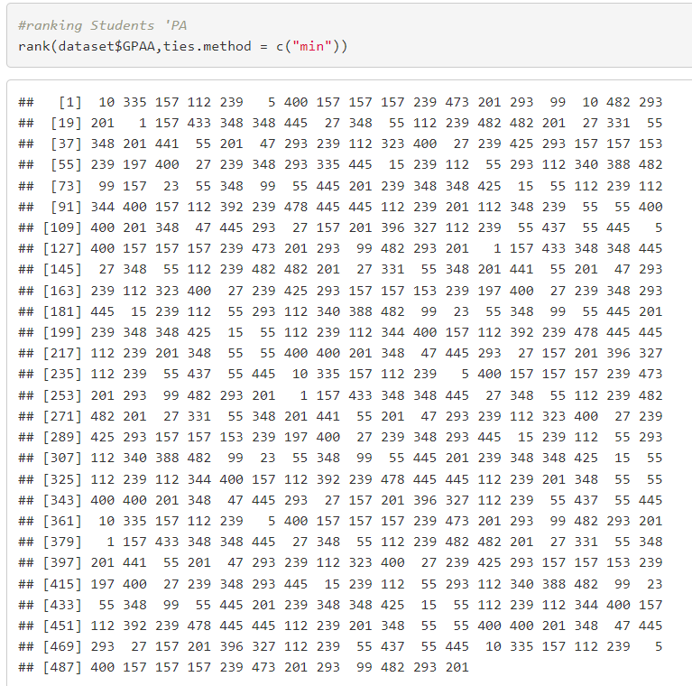
Ranking

Slide 11
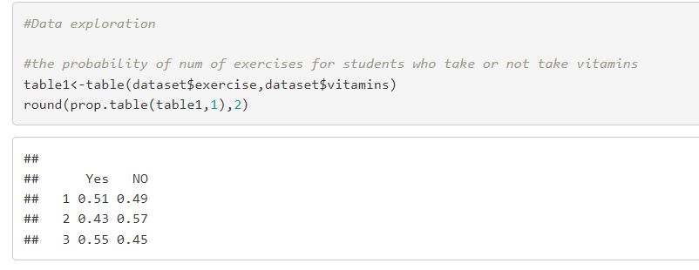
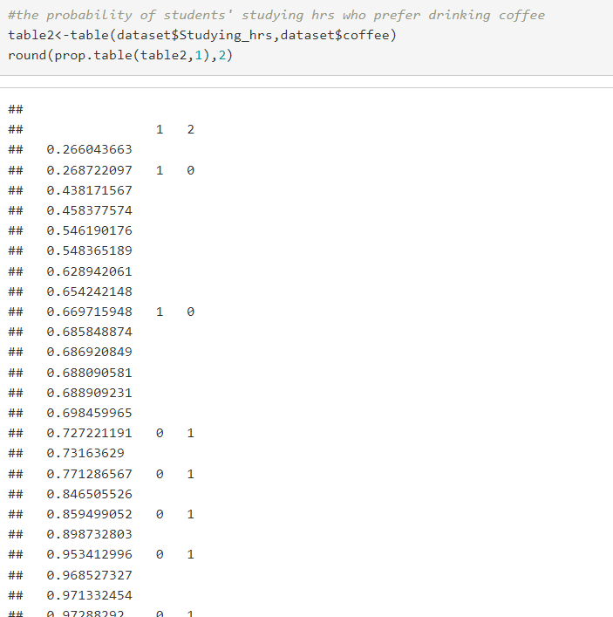
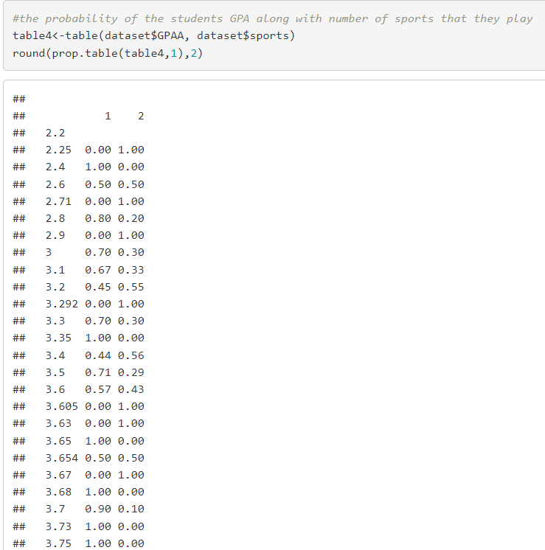
Data Exploration
The probability of the number of exercises for students who take or not take vitamins.
The probability of students' studying hours who prefer drinking coffee.
The probability of the students GPA along with number of sports that they play.

Slide 12
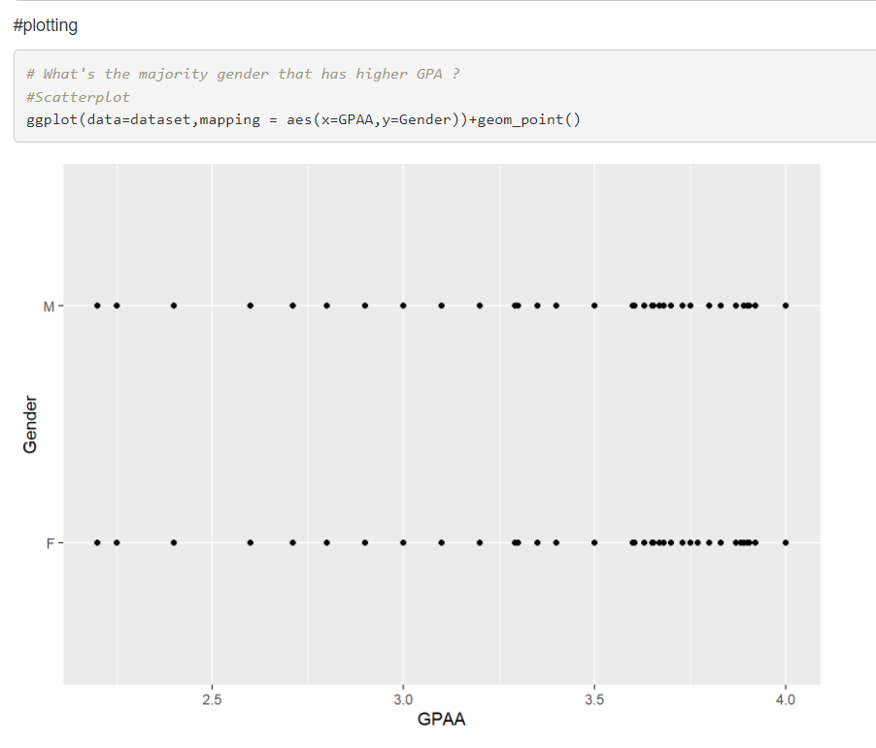
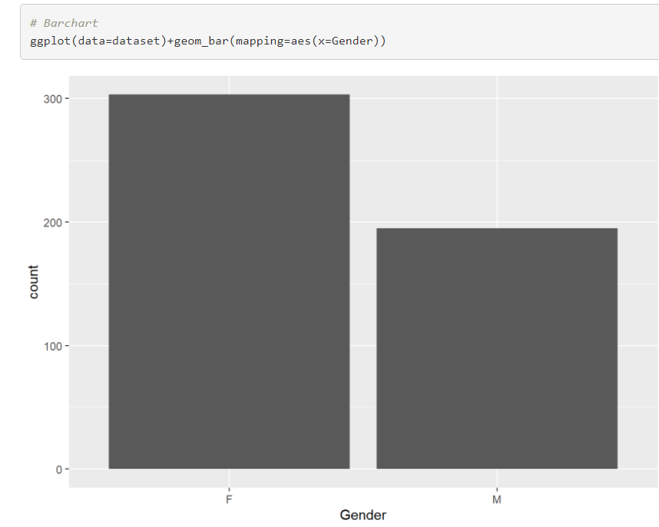
Visualization

Slide 13
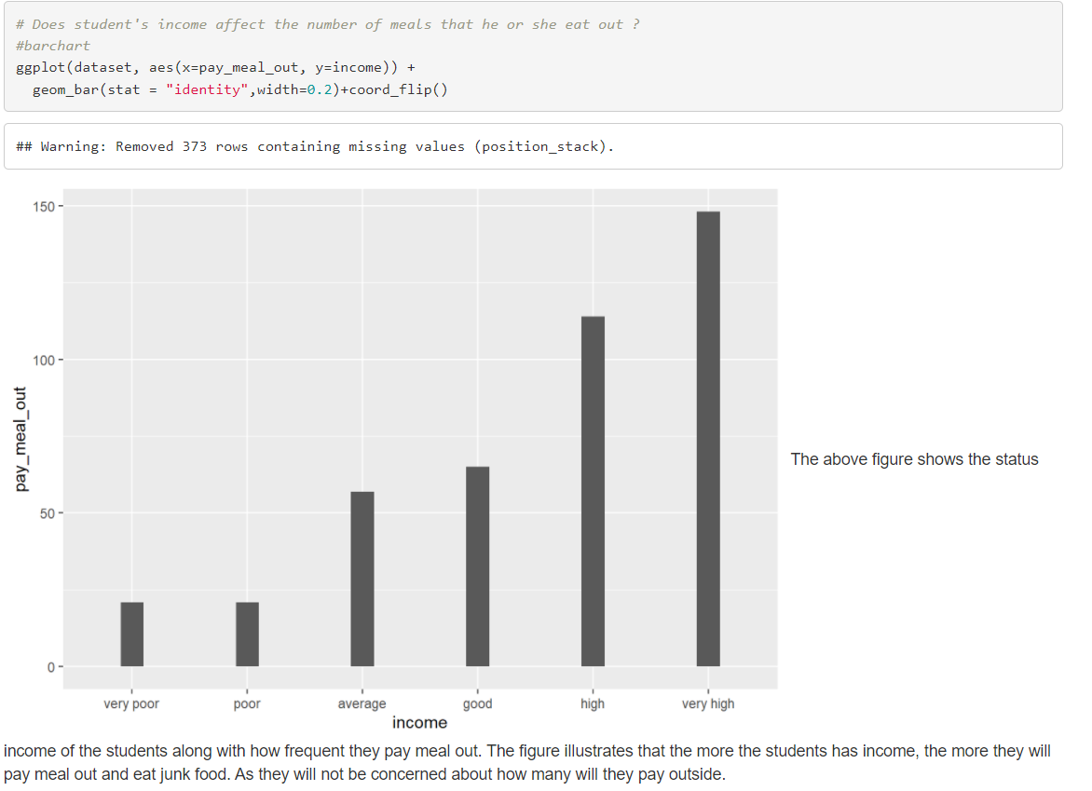
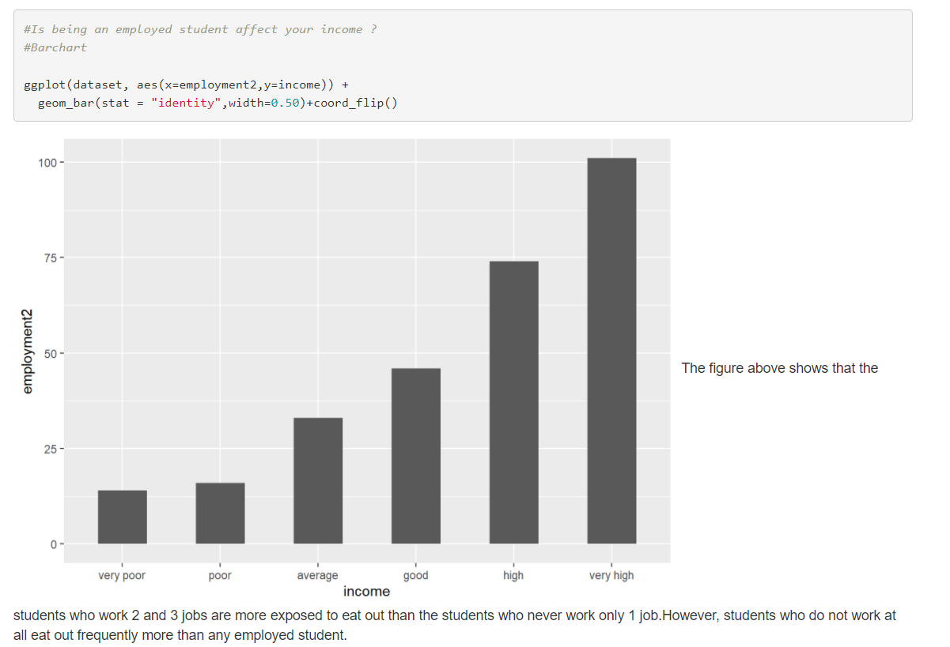
Visualization

Slide 14
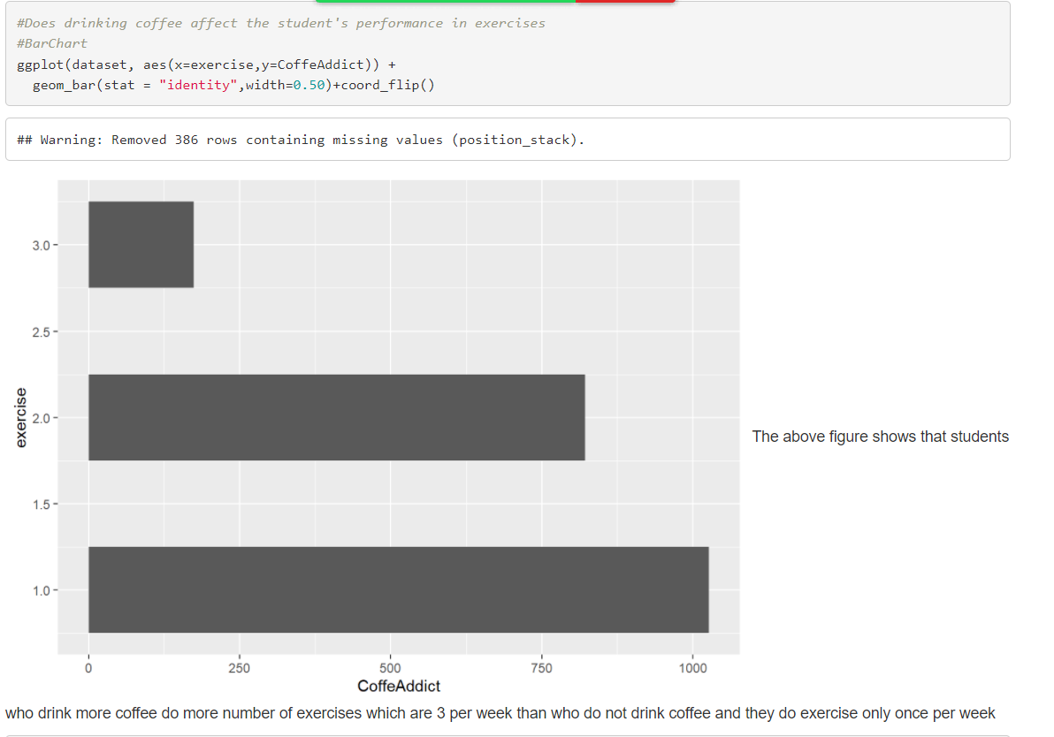
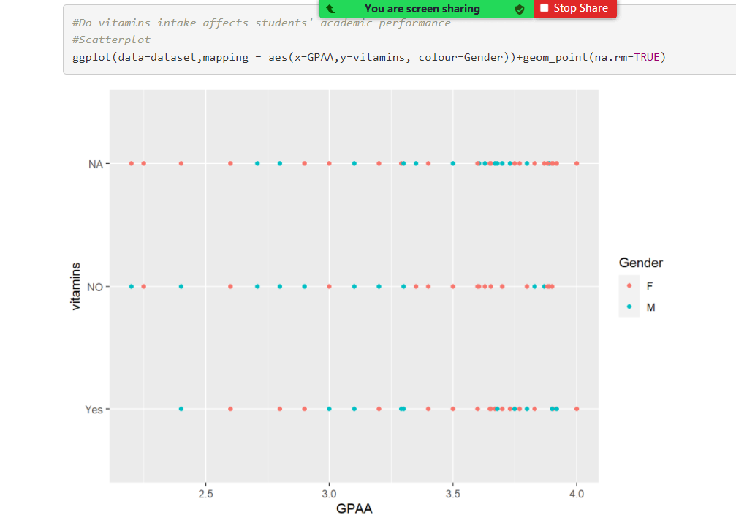

Slide 15
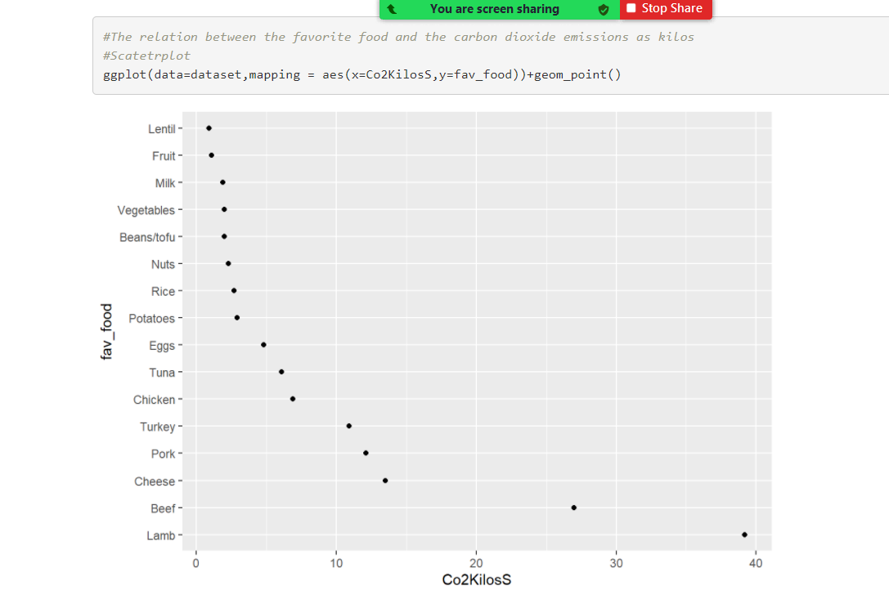
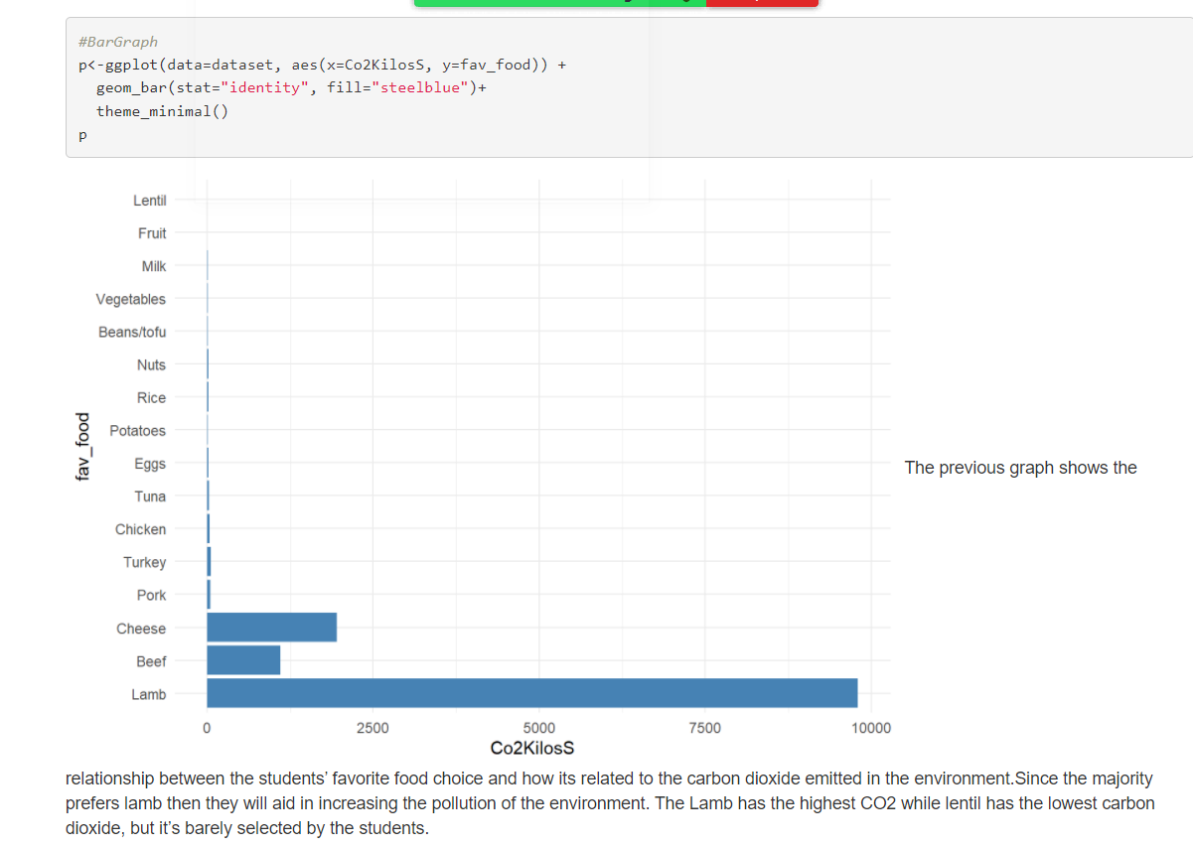

Slide 16
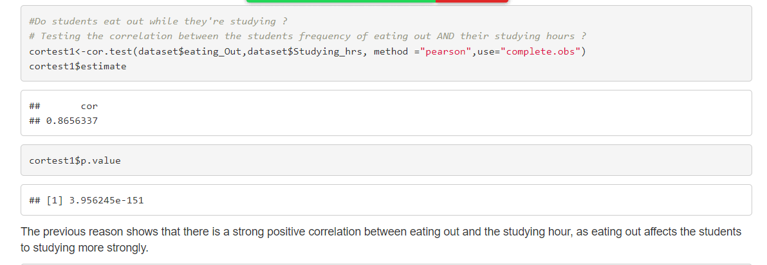
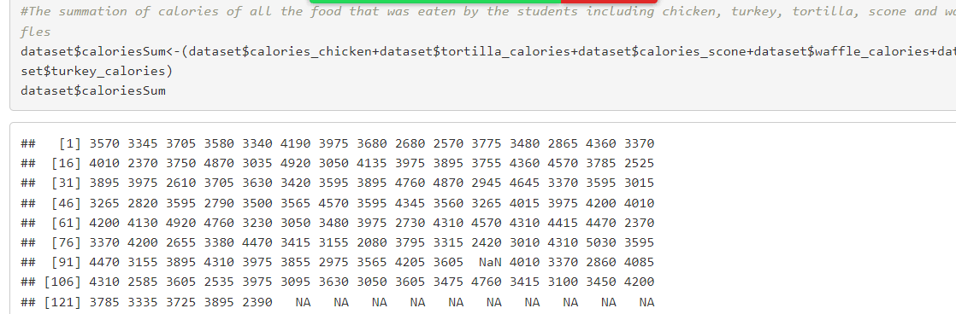
Correlation

Slide 17
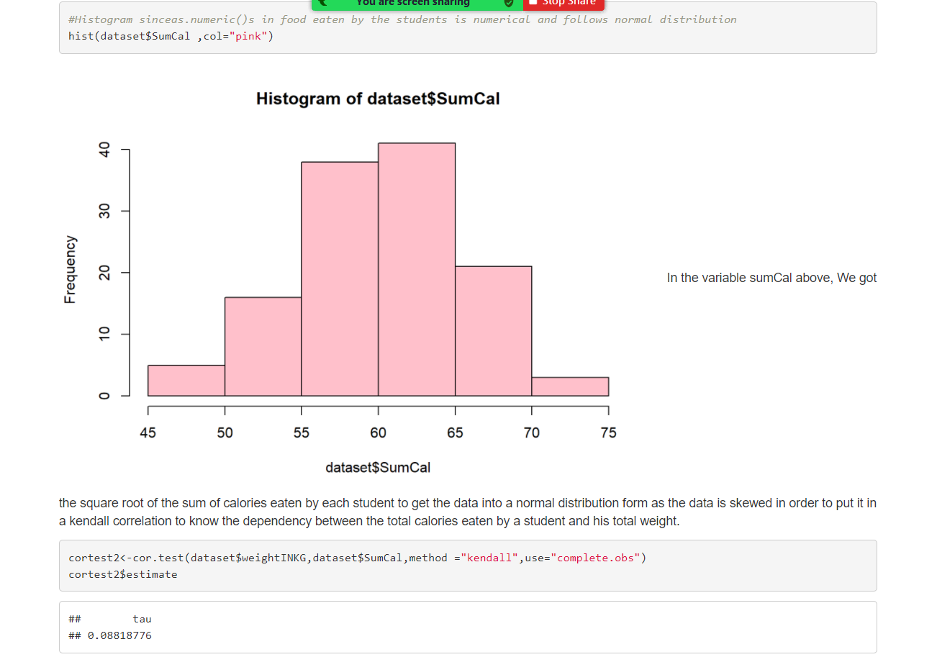
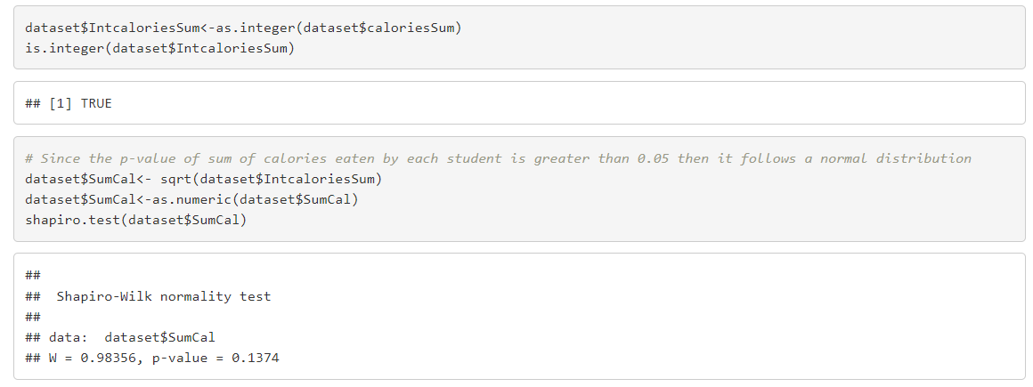
Correlation

Slide 18
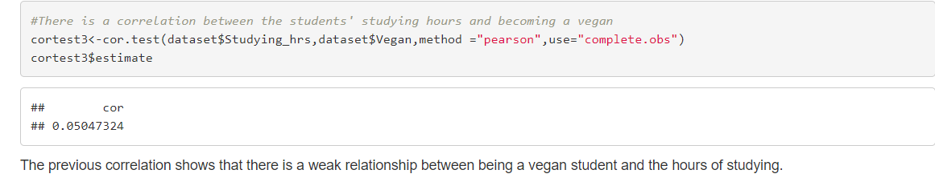
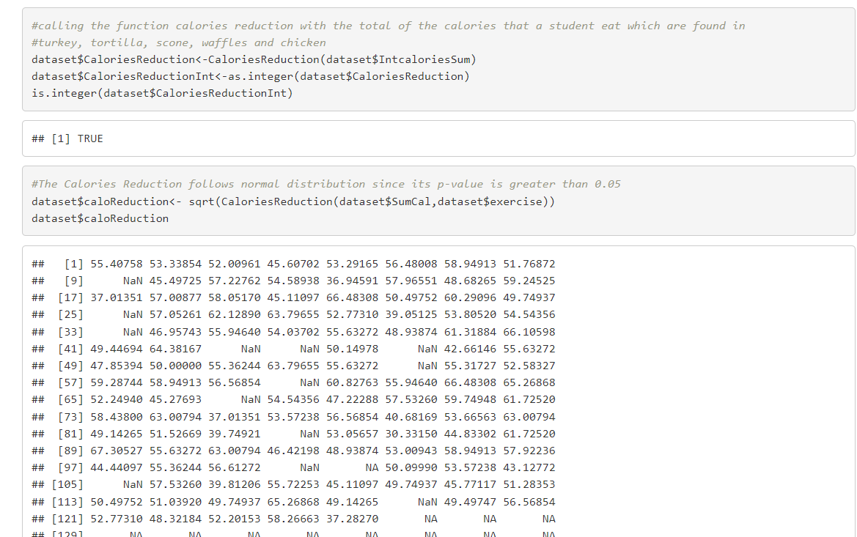
Correlation

Slide 19
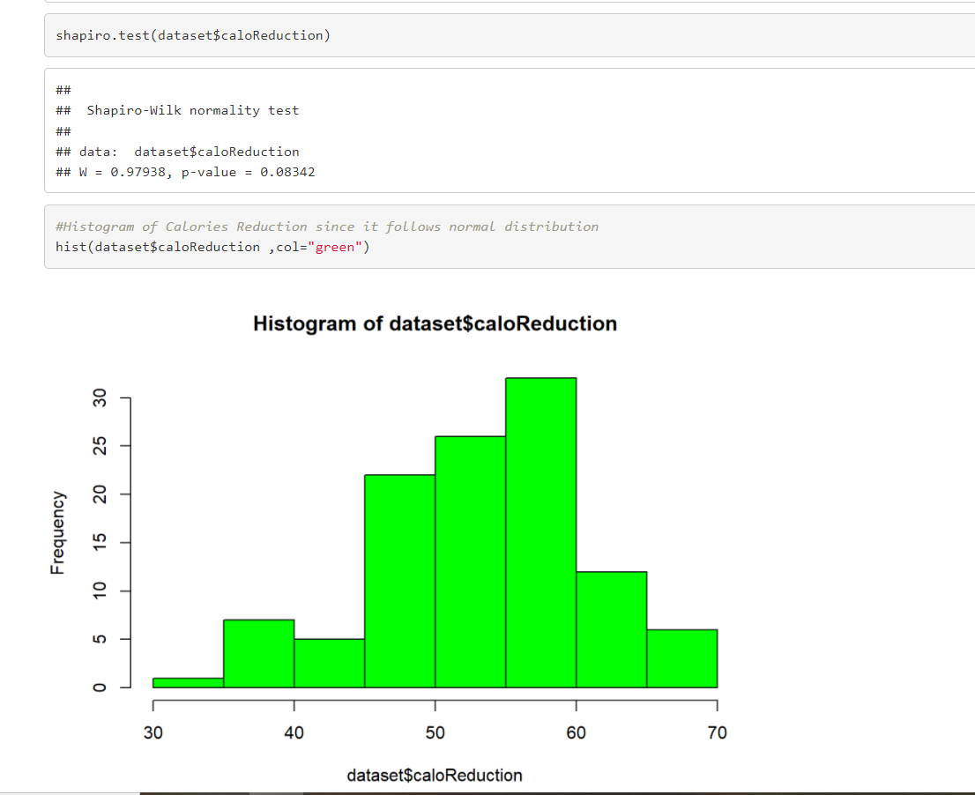
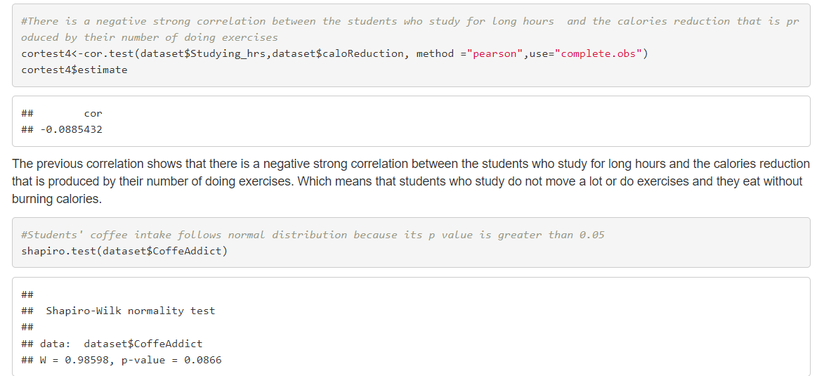
Correlation

Slide 20
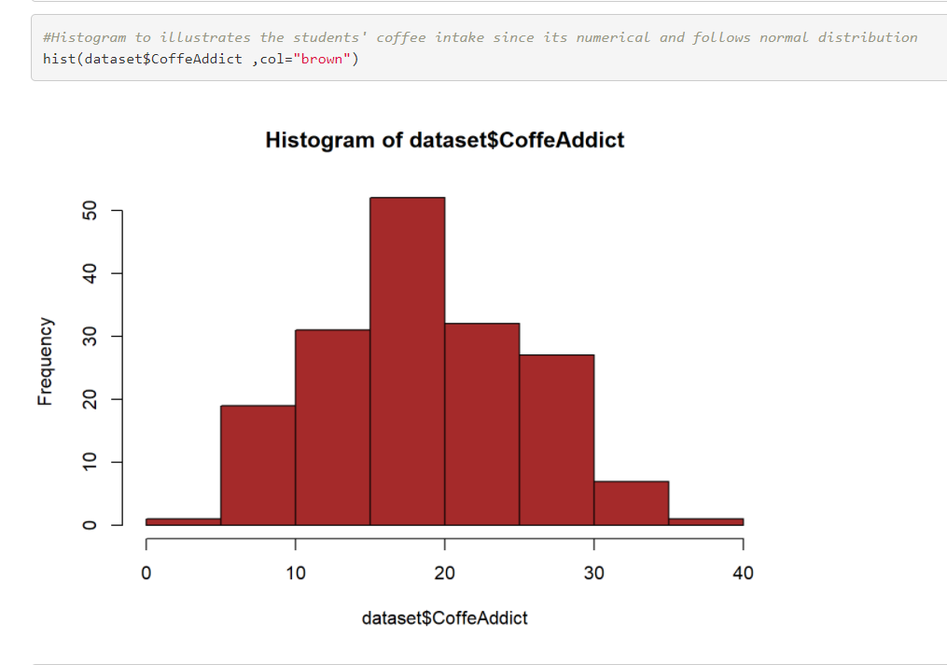
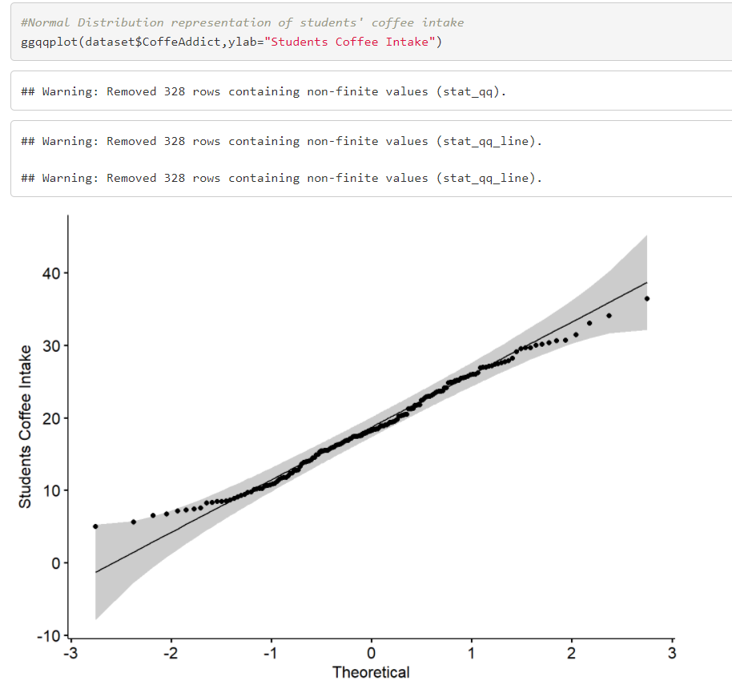
Correlation

Slide 21
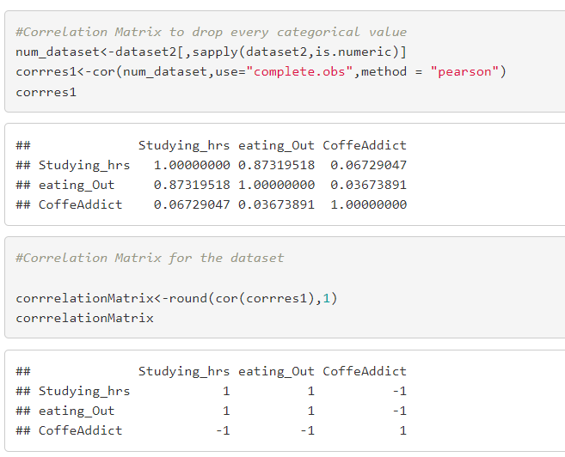
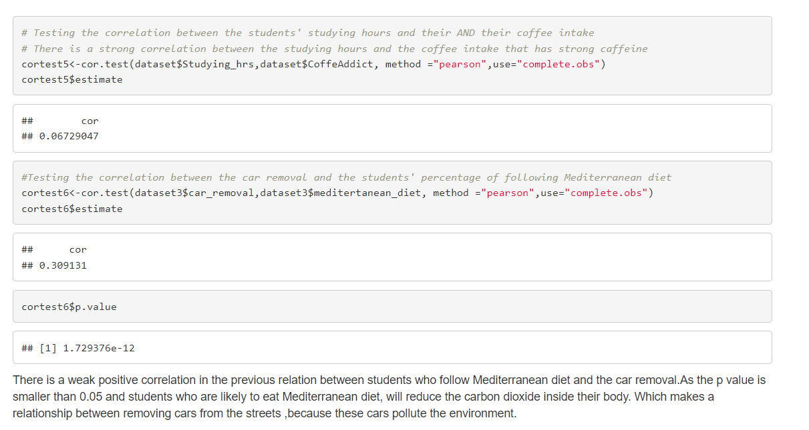
Correlation

Slide 22
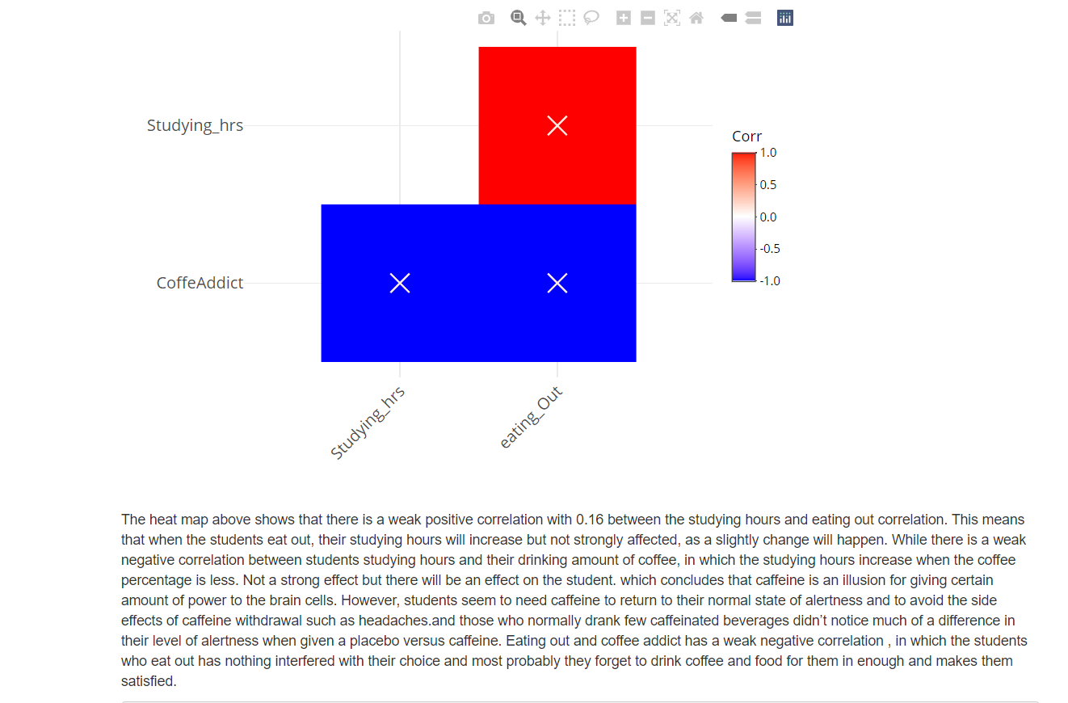
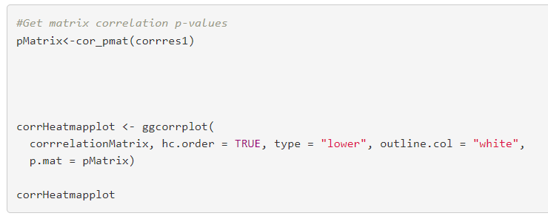
Correlation

Slide 23
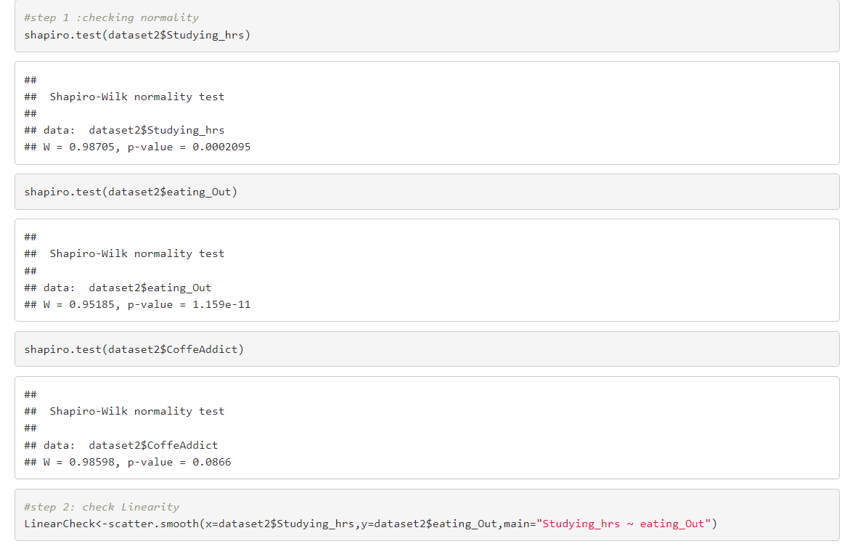
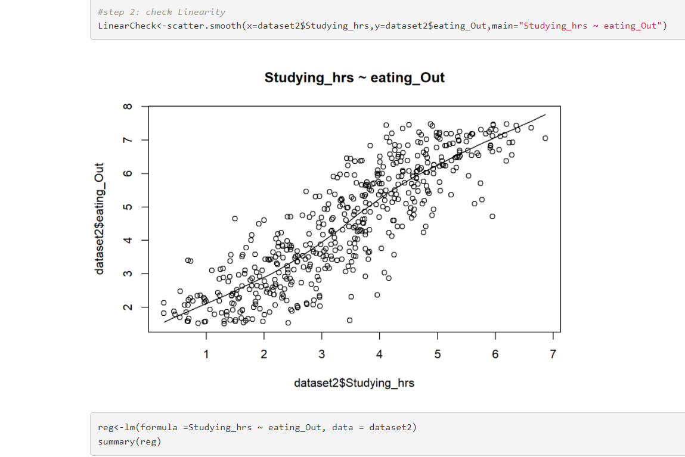
Linear Regression

Slide 24
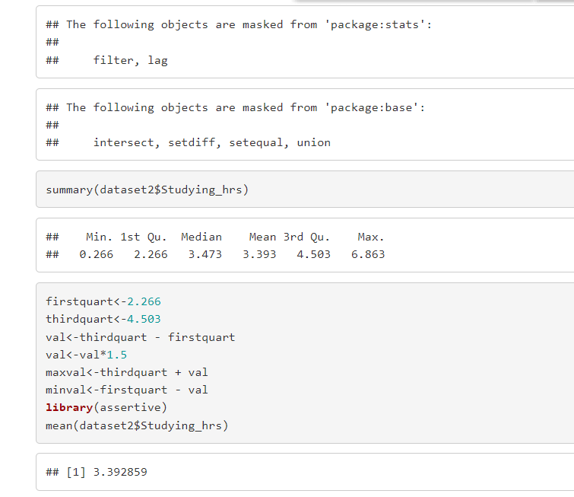
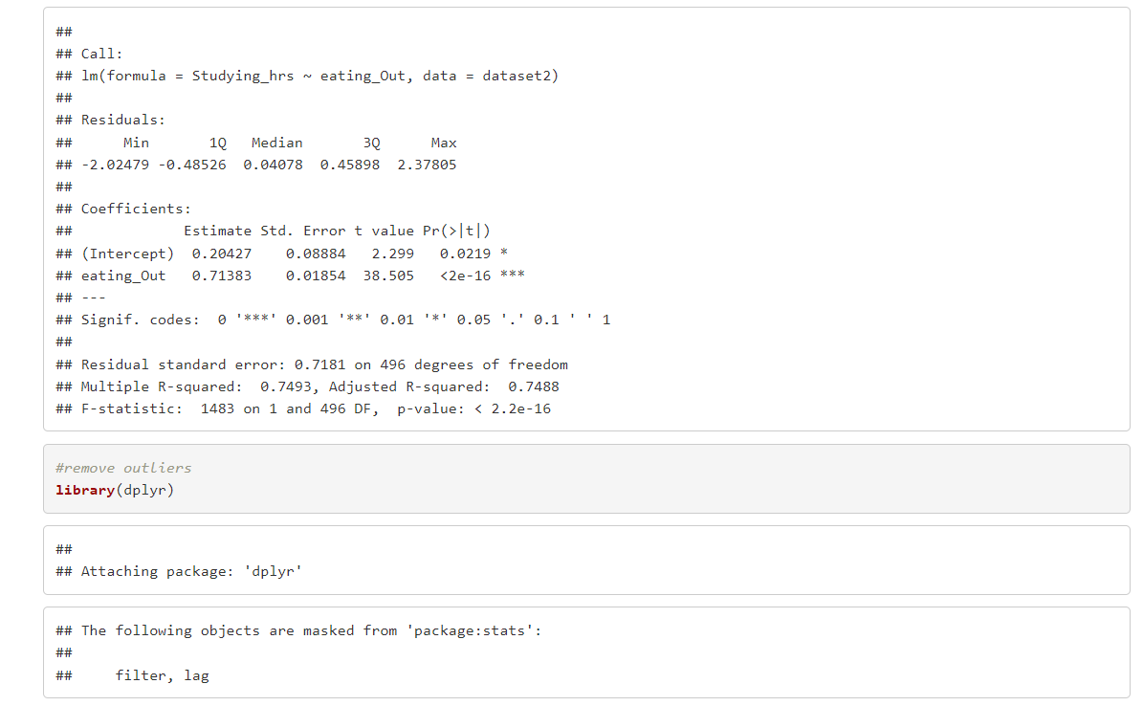
Linear Regression

Slide 25
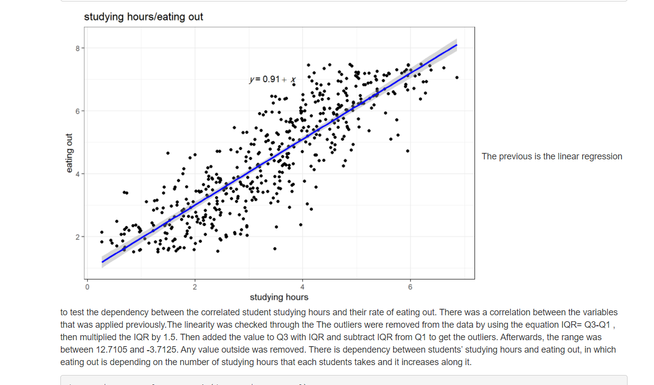
Linear Regression

Slide 26
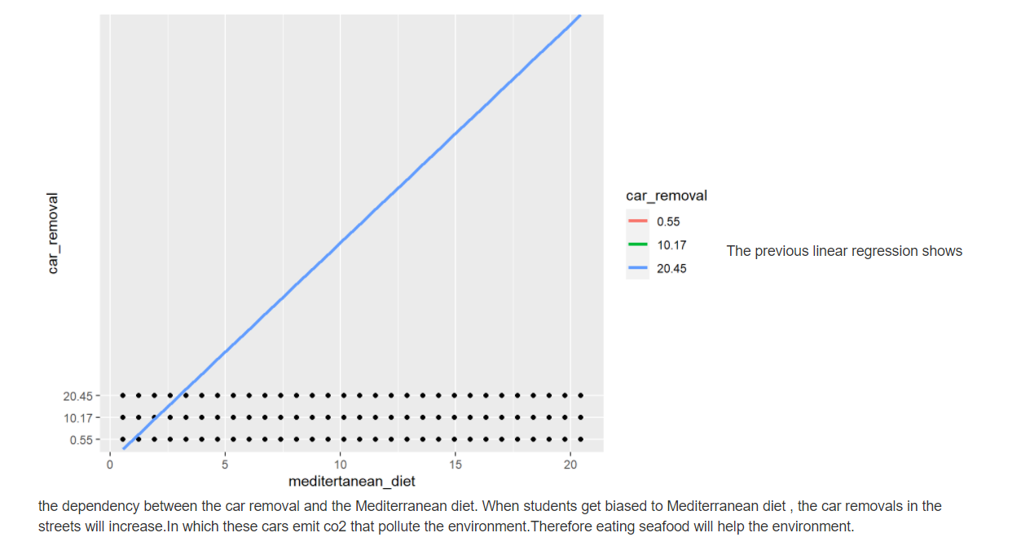
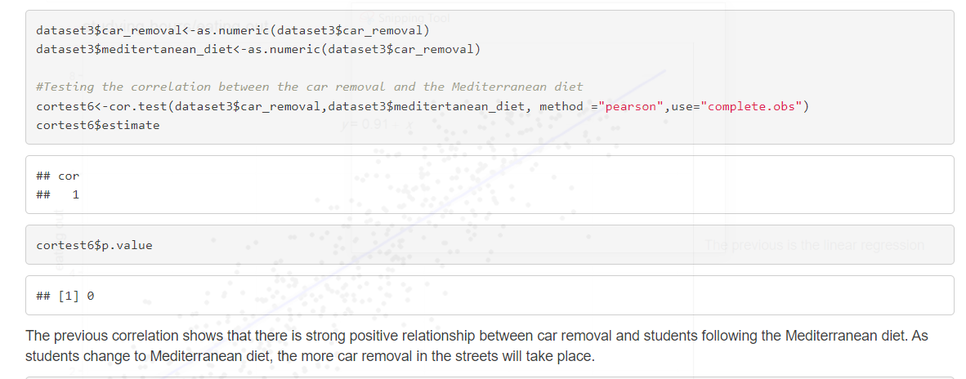
Linear Regression

Slide 27
Story
Once upon a time “Mercyhurst University” did a survey for its students. Their answers exposed their diet habits and its effect on their academic and sportive life. In addition to the effect of their choices on the outer environment that affects other people in the society.
Beginner students who do exercise only once a week depend on taking vitamins, as well as the expert students who do 3 exercises per week.
In fact, exercises appears to decrease nutrient status of the students’ bodies; therefore, vitamins increase turnover, metabolism or loss of nutrients; through biochemical adaptations as a result of training that increases nutrient needs, by increase in mitochondrial enzymes, which is the cell house in the human body that uses most of the energy released from the breakdown of nutrients to synthesize ATP.
Coffee effect was proofed to be an illusion as most students do not drink coffee and their studying hours are greater, that could reach up to 6 hours, than those who drink coffee. As an interesting fact researchers say that coffee has no benefits gain; however, it increases the risk of anxiety and raises blood pressure. And once a person has been drinking caffeine long enough, their body becomes dependent, so they experience withdrawal symptoms in the absence of caffeine. Consequently , for some, drinking a cup of coffee provides an illusion of increased alertness known as placebo effect. But , in reality, it is just normalizing their energy levels, so they go from below minimum functionality to the normal capacity of someone who doesn’t drink coffee. In response, it was found that students who drink more coffee are doing less exercises as they think that coffee is the source of their energy
.

Slide 28
Story
Sport and physical activity positively impacts students’ academic performance to get higher GPAs. as it encourages the enhancement of brain function and cognition through increasing blood flow to the brain; increasing levels of norepinephrine and endorphins; and increasing growth factors that help create new nerve cells and support synaptic plasticity.
However, playing more than one sport may distract students to focus on their academic performance to reach a 4 GPA. Concluding that it takes time more than usual in their day schedule, well they will still get high GPA, but not reaching the highest compared to playing 1 sport.
Using EDA ,it was found that the female students are more in number in the Mercyhurst University, but in the academic competition race both genders gets equivalently the same high GPAs.
Eating junk food is a habit especially in the youth generation who are at the age of college, where they don’t have time to meal prep. We tried to categorize their income status along with paying for meals out. It was shown that the students who have higher income rate will pay for junk food more , as paying for ready food will help them to eat without the headache of getting to cook.
However, students who have a poor income will not be able to afford paying out every time. They still pay and get junk food, but occasionally. But the income has an impact from the beginning on students’ life habits. As being an employed student will raise your income in order to pay for meal out. People think that when students go out and eat, that they will be distracted as going out consumes time and this will affect the students' studying hours. But it was proven extremely wrong, as students studying hour’s increases when they eat out.

Slide 29
Story
Vegan students have the same studying hours as students who eat meat and chicken. As studying hours quantity don’t define how do students eat .However, it was known that since plant-based foods can also be low in calories, a vegan diet can lead to fatigue if you don't eat enough to keep your mental and physical energy up.
Studying more don’t reduce calories which indicates that students during their studying hours eat snacks and sit without making any movement, which will not burn calories for them. Student who are likely willing to eat Mediterranean diet, which is a diet that includes healthy plant foods and seafood twice a week, are playing a huge role without noticing in the environment. As Mediterranean diet are associated with a lower environmental impact as, among other diets, they reduce greenhouse gas emissions and the use of energy, land and water. Car removal increases when the students eat Mediterranean diet. As the effect of removing cars from the streets is equivalent to eating Mediterranean diet.
In conclusion students affect themselves and other without noticing and several food choices can lead to greater food security and environmental sustainability for future generations; therefore, it’s a huge responsibility to choose what to eat.

Slide 30

Questions

Slide 31

Thank You !!

